Slide 1
Welcome to the 23rd Annual HSCF Festival
Washington DC, 2018
Monday July 2nd , 2018
Historic Opening Ceremony
ሚክፉች፡አያም።
Island Creek Elementary School
7855 Morning View Lane, Alexandria, VA 22315
2:00PM-10:00PM
Lunch and Dinner will be available for sale.

Slide 2
Tuesday July 3rd , 2018
First in its kind, Great Family Game Day along with Soccer tournament.
There will be group and individual games.
All age groups will be involved.
Group sports events such as Basketball, Volleyball, and Track & Field will be held.
Mowluud (መውሉድ) from 8:00PM – 10:00PM
Bring your individual talents to win prizes!!!
2:00PM-10:00PM
Breakfast and lunch will be available for sale
Island Creek Elementary School
7855 Morning View Lane, Alexandria, VA 22315

Slide 3
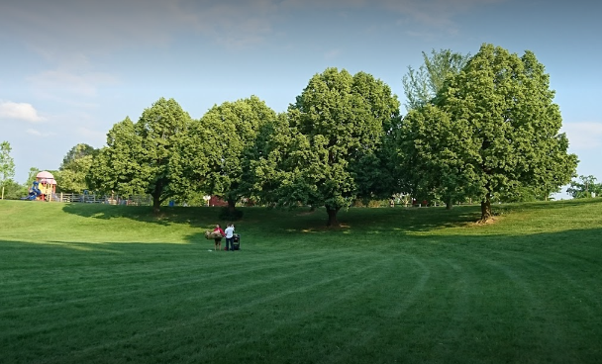
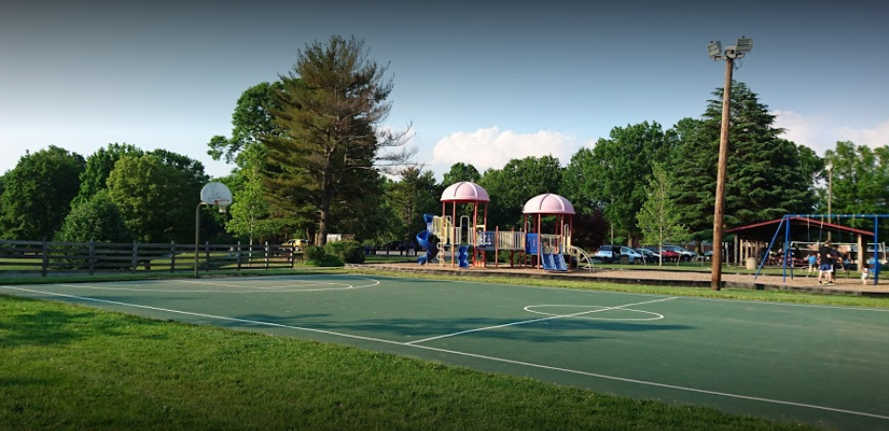
Wednesday July 4th, 2018
Picnic Day (ዚዋሪቃ) at Van Dyke Park
2:00PM to Dusk
3720 Old Lee Hwy, Fairfax, VA 22030

Slide 4
Thursday July 5th, 2018
Harari Day (ሐረሪ፡አደዋ፡ታሪኽ፡ሞይ።)
A comprehensive reflection of who we are: our past, present, and future.
Inspirational speeches by guests of Honor.
Several Harari youth talent shows.
Cultural songs by the talented singers Adib Abdosh, Atham Aduus, and more.
Multiple short skits that reflect Harari culture and history.
Northern Virginia Community College-Annandale Campus
8333 Little River Turnpike, Annandale, VA 22003
3:00PM-10:00PM

Slide 5


Friday July 6th,2018
Soccer tournament Final from 10:00 AM - 12:30PM
Jumma(ጁምአ) Prayer from 1:00PM – 2:00PM.
Award Ceremony and Harari Music Night!
The Waterford Reception Center
6715 Commerce St, Springfield, VA 22150
9:00PM – 2:00AM
Island Creek Elementary School
7855 Morning View Lane, Alexandria, VA 22315

Slide 6
Saturday July 7th, 2018
Discussion forum concerning Harar’s current Political, Social and economical issues.
Franconia Governmental Center
6121 Franconia Rd, Alexandria, VA 22310
11:00AM – 3:00PM
Gala Night!
Stacy C. Sherwood Community Center
3740 Old Lee Hwy, Fairfax, VA 22030
9:00PM – 2:00AM

Slide 7
Lodging Information
Courtyard by Marriott Springfield
Address: 6710 Commerce Street, Springfield, VA 22150
Phone: (703) 924-7200
Mention : The 23rd HSCF Festival or Click the link below
Book your group rate for the 23rd HSCF Group
Residence Inn Springfield Old Keene Mill
Address: 6412 Backlick Road, Springfield, VA 22150
Phone: (703) 644-0020
Mention : The 23rd HSCF Festival or Click the link below
Book your group rate for the 23rd HSCF Festival

